Slide 1

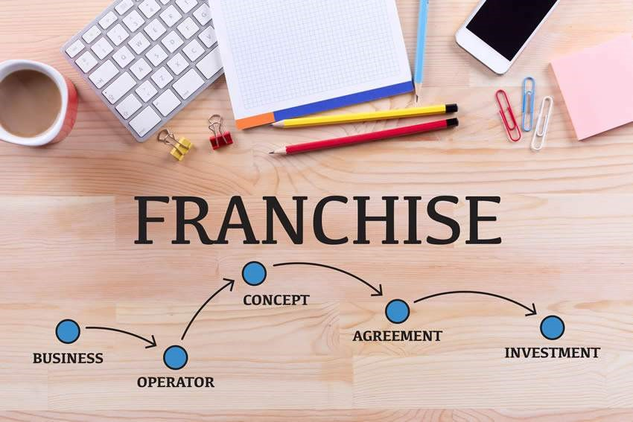
Starting a Franchisee in India

Slide 2

What is Franchisee
Franchise business is a popular and profitable way of expanding a brand and reaching new customers. Wherein the franchisor grants the rights to use their business name, products, and services to another entity (franchisee) in exchange for a fee.
Partnership Trademark opposition assignment examination renewal OPC regn in Ahmedabad Bangalore bilaspur chandigarh chennai cuttack dehradun delhi ncr gwalior Himachal Pradesh hyderabad OPC regn in India jaipur rajasthan JK kanpur Kochi Kolkata Mumbai Panaji Patna Puducherry llp regn in Gujrat Tamil Nadu Chattisgarh Chandigarh Odisha Uttarakhand Delhi MP Himachal Pradesh Telangana India Rajasthan Kashmir UP Kerala WB Maharashtra Goa Bihar Pondicherry Jharkhand AP Karnataka Pvt Ltd regn in Gujrat Karnataka Chattisgarh

Slide 3
Benefits of Franchising
Access to an established brand name, customer base, and market reputation.
Reduced risk of failure and lower investment costs compared to starting a new business from scratch.
Support and guidance from the franchisor in terms of training, marketing, operations, and quality control.
Opportunity to leverage the franchisor’s network, expertise, and innovation.
Chandigarh Tamil Nadu Odisha Uttarakhand Delhi MP Himachal Pradesh Telangana Rajasthan Kashmir UP Kerala WB Maharashtra Goa Bihar Pondicherry Jharkhand AP Gujarat Bangalore Chattisgarh Chandigarh Chennai Odisha Dehradun Delhi MP Himachal Pradesh Telangana India Rajasthan Kashmir UP Kerala WB Maharashtra Goa Bihar Pondicherry Jharkhand AP Conversion to LLP in India Conversion to Pvt Ltd in India Concersion LLP to Pvt Ltd India Conversion Partnership to Pvt Ltd. India conversion Pvt Ltd to LLP

Slide 4
Challenges of Franchising
Finding the right franchisor and franchisee match that suits your goal and budget
Negotiating the terms and conditions of the franchise agreement,
Complying with the legal and regulatory requirements of the franchising sector, including, licenses, permits, registrations, and approvals from various authorities.
Maintaining the standards and expectations of the franchisor and the customers, while also adapting to the local market conditions and preferences.
Ranchi Vijayawada patent filing India Udyam certificate ISO certification ESI registration epfo regn gst regn trademark regn delhi ncr chandigarh ahmedabad bangalore bilaspur Chennai Cuttack Dehradun Gwalior hyderabad Jaipur JK Kanpur Kochi Kolkata Mumbai Panaji Patna Puducherry Ranchi Vijayawada Lucknow Himachal Pradesh Gurugram pune Noida FSSAI regn in India Bangalore Bilaspur Ahmedabad Chandigarh Chennai Cuttack Dehradun Delhi NCR Gwalior Himachal Pradesh Hyderabad Jaipur JK Kanpur Lucknow Noida kochi Kolkata

Slide 5
Steps Involved
Market research to identify TG, growth opportunity, competitors etc.
Evaluate your financial capacity
Shortlisting of the franchisors
Apply for evaluation
Draft and sign a franchise agreement specifying the rights and obligations of both parties, such as the territory, duration, royalty, marketing, termination, etc.
Setting up your franchise, hiring, procurements, equipment, inventory, and supplies, obtaining licenses and permits, etc.
Final Launch
Mumbai Panaji Patna Puducherry Ranchi Vijayawada Dpiit regn in India ahmedabad bangalore bilaspur chandigarh Chennai Cuttack Dehradun Delhi NCR Gwalior Himachal Pradesh Hyderabad Jaipur JK Kanpur NOida Lucknow kochi Kolkata Mumbai Pune Panaji Patna Puducherry Ranchi vijayawada Ludhiana Copyright regn in India ahmedabad bangalore bilaspur chandigarh Ludhiana Chennai Cuttack Delhi NCR Gwalior Himachal Pradesh Hyderabad Jaipur JK conversion OPC to Pvt Ltd Conversion Prop to OPC Conversion Prop to

Slide 6
Thankyou Read here to know more
Accounting Services
Sole Proprietorship
Partnership
Private Limited Company
Limited Liability Company
Digital Signature Certificate
GST Registration
Professional Tax Registration
DPIIT Registration
MSME Registration
Trademark Registration
Annual Compliances
Copyright Registration
Share Valuation Report
Agreements

